Slide 1

Unit-1 Introduction to Computer Networks
Computer Networks (CN)
DU #2305CS332
Prof. Devangi L. Kotak
Department of Computer Application
Devangi.kotak@darshan.ac.in

Slide 2

Looping
Outline
What is Computer Network?
Advantages of Computer Network
Applications of Computer Network
Type of Computer Network
What is Internet?
The Network Edge & The Network Core
Transmission Media
Network Topologies
Protocol Layers
Delay, Loss & Throughput

Slide 3
What is Computer Network?
Computer Network is a system in which multiple computers are connected to each other to share information and resources.
Network
Devices
Wireless
Computers
Wired

Slide 4


Advantages of Computer Network
File Sharing
Flexible Access
Better Communication
Entertainment

Slide 5
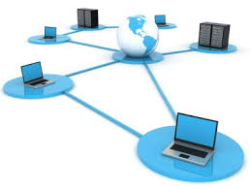
Advantages of Computer Network
Internet Access
Inexpensive System
Instant and Multiple Access
Resource Sharing

Slide 6




Applications of Computer Network
Email Services
Teleconferencing
Business & Finance
File & Directory Services
& Many More….

Slide 7
Types of Computer Network
Computer networks can be categories by their size as well as their purpose.
The size of a network can be expressed by the geographic area.
Some of the different networks based on size are:
Network
Local Area Network
(LAN)
Metropolitan Area Network
(MAN)
Wide Area Network
(WAN)

Slide 8

Local Area Network
A local area network (LAN) is a computer network that interconnects computers within a limited area such as a residence, school, laboratory, university campus or office building.

Slide 9
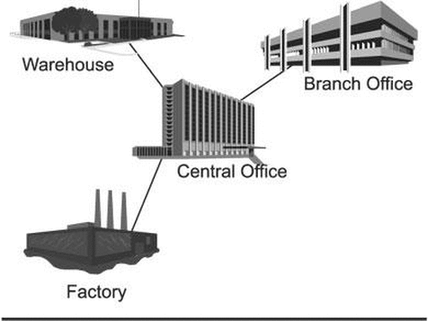
Metropolitan Area Network
A metropolitan area network (MAN) is a computer network that interconnects with computer in a metropolitan area like city.
MAN is a larger than LAN but smaller than the area covered by a WAN.
It is also used to interconnection of several local area network.
Navagam
Morbi
Rajkot
Shapar

Slide 10
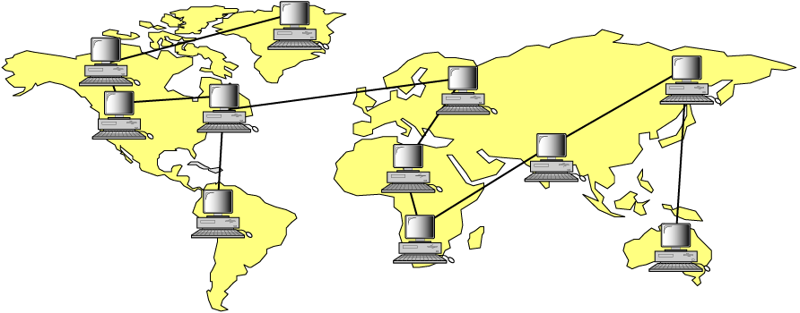
Wide Area Network
A wide area network (WAN) is a computer network that exists over a large-scale geographical area.
A WAN connects different networks, including local area networks (LAN) and metropolitan area networks (MAN).
It may be located with in a state or a country or it may be interconnected around the world.
Asia
America
Africa

Slide 11
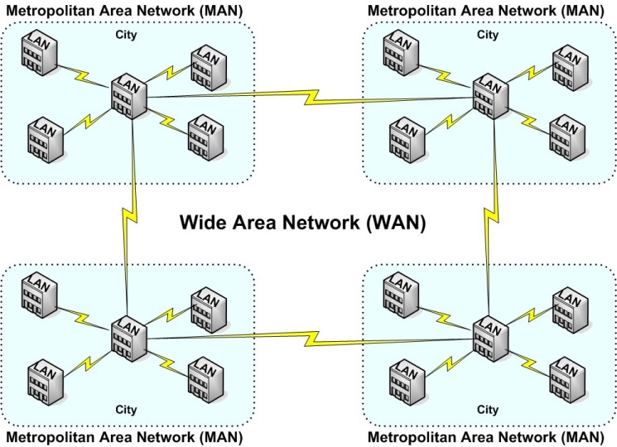
Types of Computer Networks - Summary

Slide 12
Types of Computer Networks - Summary
Comparison | LAN | MAN | WAN
Full Name | Local Area Network | Metropolitan Area Network | Wide Area Network
Meaning | A network that connects a group of computers in a small geographical area | It covers relatively large region such as cities, towns | It spans large locality & connects countries together. e.g. Internet
Ownership of Network | Private | Private or Public | Private or Public (VPN)
Design and Maintenance | Easy | Difficult | Difficult
Propagation Delay | Short | Moderate | Long
Speed | High | Moderate | Low
Equipment Used | NIC, Switch, Hub | Modem, Router | Microwave, Radio Transmitter & Receiver
Range(Approximately) | 1 to 10 km | 10 to 100 km | Beyond 100 km
Used for | College, School, Hospital | Small towns, City | State, Country, Continent

Slide 13





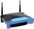




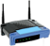


What is Internet?
The internet is a type of world-wide computer network.
The internet is the collection of infinite numbers of connected computers that are spread across the world.
Mobile Network
Network Components
Global ISP
PC
Home
Network
server
Regional ISP
wireless
links
wireless
laptop
Wired link
smartphone
router
Institutional
Network

Slide 14
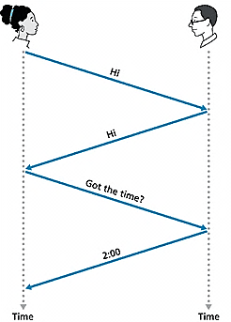
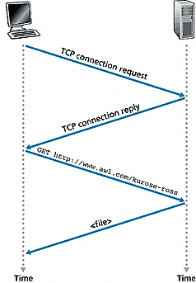
What is Protocol?
Network Protocol
Set of rules
Machines rather than humans.
All communication activity in Internet governed by protocols.
Human Protocol(Language)
“what’s the time?”
“I have a question”
Introduction Talk
Protocol defines the format, order of message that sent and received among network entities, and actions taken on message transmission and reception.

Slide 15
A closure look at network structure
Component of internet
Network edge:
applications and hosts
Network core:
routers
network of networks
Access networks, physical media:
communication links

Slide 16


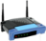

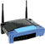


The Network Edge
Computers and other devices are connected at the edge (end) of the network.
These computers are known as hosts or end systems. Router is known as edge router.
mobile network
Global ISP
What are other end devices?
Home
Network
Regional ISP
Institutional
Network

Slide 17


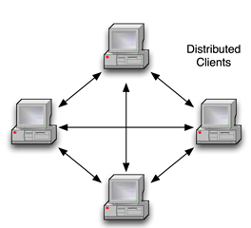
Peer to Peer Network
Computers are connected together so that users can share resources and information.
There is no central server for authenticating users, each of them works as both client and server.
e.g. Bit Torrent

Slide 18
Client – Server Network
Client: Request servers for a task.
Generally called desktop PCs or workstations.
Server: Receive requests from the clients. Process and response them.
e.g. Web Server, Email Server

Slide 19
The Network Core
Defines the connection of different network segments together and process to transmit data packets across the network.
It is implemented through the use of switching techniques.
Switched
Networks
Circuit-Switched
Networks
Packet-Switched
Networks

Slide 20
Circuit Switched Network
A dedicated channel has to be established before the call is made between users.
The channel is reserved between the users till the connection is active.
For half duplex(one way) communication, one channel is allocated and for full duplex(two way) communication, two channels are allocated.
It is mainly used for voice communication requiring real time services without delay.

Slide 21
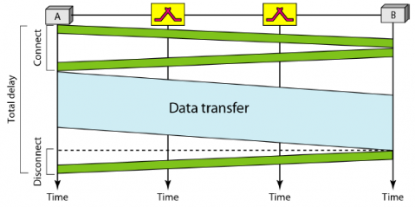
Circuit Switched Network – Cont…
Communication via circuit switching involves three phases:
Circuit Establishment
Data Transfer
Circuit Disconnect

Slide 22
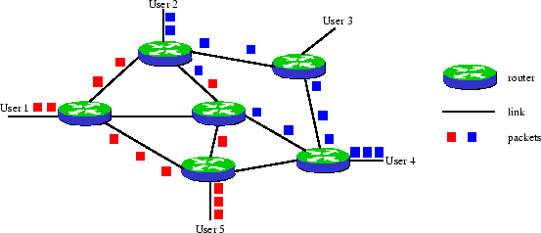
Packet Switched Network
It is not required to establish the connection initially.
The connection/channel is available to use by users. But when traffic or number of users increases then it will lead to congestion in the network.
Packet switched networks are mainly used for data and voice applications requiring non-real time scenarios.

Slide 23
Differences
Circuit Switching | Packet Switching
Dedicated path between source and destination | No dedicated path
All packets use same path | Packets travel independently
Reserve the entire bandwidth in advance | Does not reserve bandwidth
Bandwidth wastage | No bandwidth wastage
No store and forward transmission | Supports store and forward transmission

Slide 24
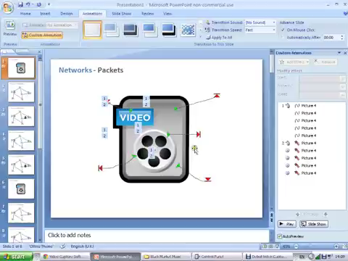
Switching Network

Slide 25
Transmission Media

Slide 26
Transmission Media
A transmission media can be defined as any medium that can carry information from a source to a destination.
Transmission Media
Guided Media (Wired)
Unguided Media (Wireless)
Twisted-Pair Cable
Coaxial Cable
Fiber Optic Cable
Radio Wave
Microwave
Infrared Wave

Slide 27
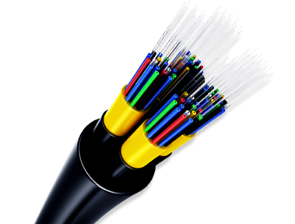
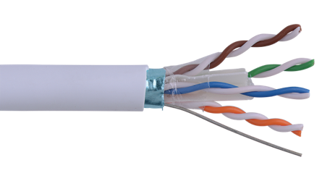
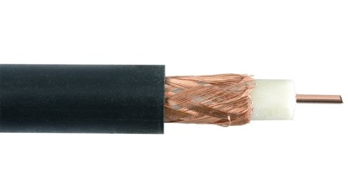
Guided Media
Guided media are those that provide a wired - channel from one device to another.
Three Guided media commonly used for data transmission are:
Twisted Pair Cable
Coaxial Cable
Fiber Optic Cable

Slide 28
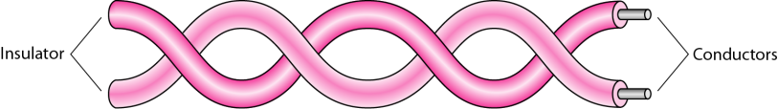
Twisted Pair Cable
It is a physical media made up of a pair of cables twisted with each other.
It is cheap as compared to other transmission media.
Installation of the cable is easy, and it is a lightweight cable.
The frequency range for cable is from 0 to 3.5KHz.
It consists of two insulated copper wires arranged in a regular spiral pattern.
The degree of reduction in noise interference is determined by the number of turns per foot.
Increasing the number of turns per foot decreases noise interference.

Slide 29
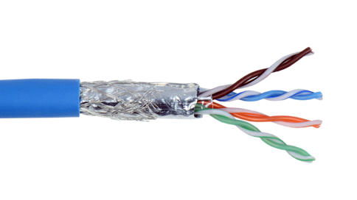
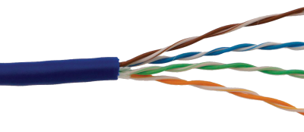
Twisted Pair Cable - Cont.
Separately insulated.
It is widely used in different kinds of data and voice infrastructure.
The use of two wires twisted together helps to reduce crosstalk and electromagnetic induction.
Two types of twisted pair cable:
UTP
(Unshielded Twisted Pair)
STP
(Shielded Twisted Pair)

Slide 30
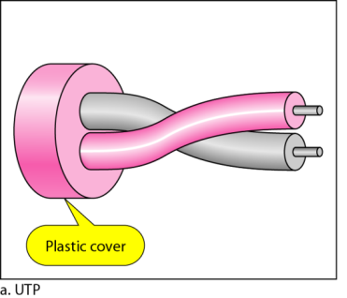
Unshielded Twisted Pair Cable
An unshielded twisted pair is widely used in telecommunication.
Ordinary telephone wires.
Weak immunity against noise & interferences.
Following are the categories of UTP:
Category 1: Used for telephone lines that have low-speed data.
Category 2 & 3 : It can support up-to 4Mbps & 16Mbps.
Category 4: It can support up-to 20Mbps.
It can be used for long-distance communication.
Category 5: It can support up-to 200Mbps.
Advantages:
It is cheap.
Installation of the unshielded twisted pair is easy.
It can be used for high-speed LAN.
Disadvantage:
This cable can only be used for shorter distances because of attenuation(weakening)

Slide 31
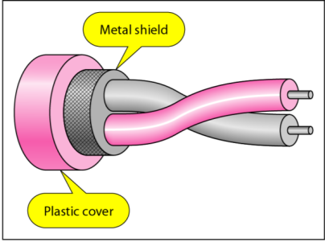
Shielded Twisted Pair Cable
A shielded twisted pair is a cable that contains the mesh surrounding the wire that allows the higher transmission rate.
An installation of STP is easy.
It has a lower attenuation.
It is shielded that provides the higher data transmission rate.
It is more expensive as compared to UTP and coaxial cable.
It has higher capacity as compared to unshielded twisted pair cable.
Used in exterior network(outside of building).

Slide 32
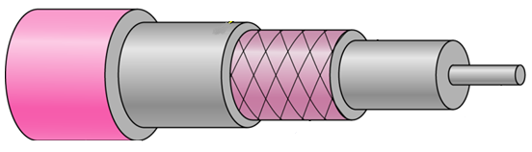
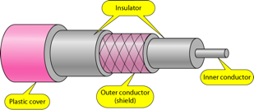
Coaxial Cable
Outer conductor is braided shield.
Inner conductor is solid metal.
Separated by insulating material, and whole cover by plastic cover.
The middle core is responsible for the data transferring whereas the copper mesh prevents from the EMI(Electromagnetic interference).
Insulator
Inner Conductor
Plastic cover
Outer conductor (shield)

Slide 33
Coaxial Cable – Cont.
Used in television, long distance telephone transmission.
It has excellent noise immunity.
It has a higher frequency as compared to Twisted pair cable.
Coaxial cable is of two types:
Baseband transmission:
It is defined as the process of transmitting a single signal at high speed.
Broadband transmission:
It is defined as the process of transmitting multiple signals simultaneously.

Slide 34
Coaxial Cable – Cont.
Advantages Of Coaxial cable:
The data can be transmitted at high speed.
It has better shielding as compared to twisted pair cable.
It provides higher bandwidth.
Disadvantages Of Coaxial cable:
It is more expensive as compared to twisted pair cable.
If any fault occurs in the cable causes the failure in the entire network.

Slide 35
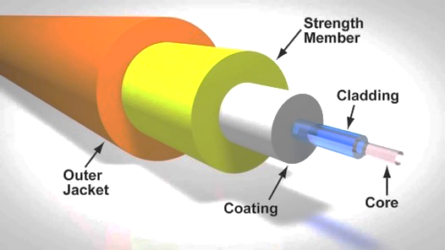
Fiber Optic Cable
A fiber-optic cable is made of glass or plastic and transmits signals in the form of light.
A glass or plastic core is surrounded by a cladding of less dense glass or plastic.
The difference in density of the two materials must be such that a beam of light moving through a core is reflected off the cladding instead of being refracted into it.
Optical fibers use reflection to guide light through a channel.

Slide 36
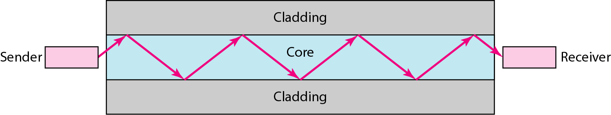
Fiber Optic Cable – Cont.
Core: The optical fibre consists of a narrow strand of glass or plastic known as a core.
Cladding: The concentric layer of glass is known as cladding.
Jacket: The protective coating consisting of plastic is known as a jacket.
Light travels in a straight line as long as it is moving through a single uniform substance.

Slide 37
Fiber Optic Cable – Advantages
It provide faster data transmission than copper wires.
It carries the data at a longer distance as compared to copper cable.
Small size & weight.
Better Reliability.
Used in high bandwidth network.
High data rate & lower attenuation.

Slide 38
Unguided Media
An unguided transmission transmits the electromagnetic waves without using any physical medium.
Therefore it is also known as wireless transmission.
In unguided media, air is the media through which the electromagnetic energy can flow easily.
This type of communication is often referred to as wireless communication.
Radio wave
Microwave
Infrared Wave

Slide 39
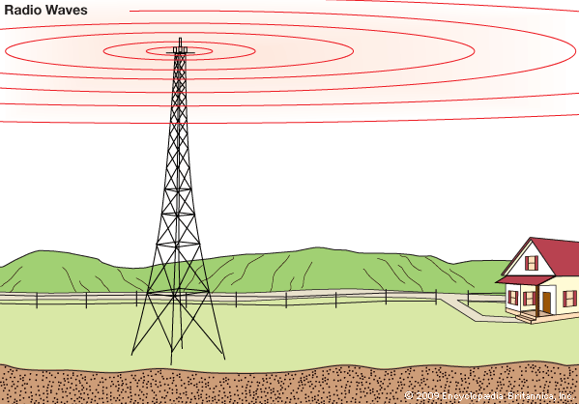
Radio Wave
Radio waves are the electromagnetic waves that are transmitted in all the directions of free space.
Radio waves are omnidirectional(all direction).
The signals are propagated in all the directions.
An example of the radio wave is FM radio.
The range in frequencies of radio waves is from 3KHz to 1GHz.
The sending and receiving antenna are not aligned.
The wave sent by the sending antenna can be received by any receiving antenna.
An example of the radio wave is FM radio.

Slide 40


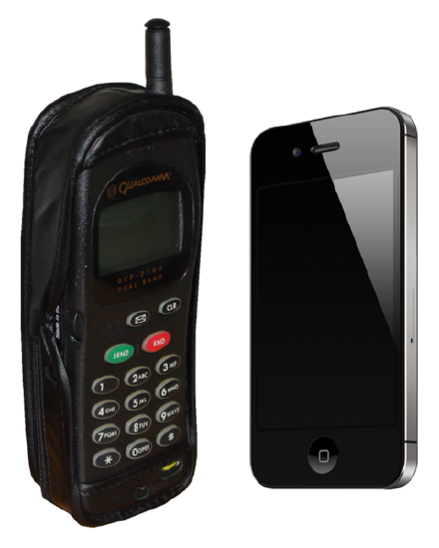
Radio Wave – Cont.
Applications:
A Radio wave is useful for multicasting when there is one sender and many receivers.
An FM radio, television, cordless phones are examples of a radio wave.
Advantages:
Radio transmission is mainly used for wide area networks and mobile cellular phones.
It covers a large area, and they can penetrate the walls.
Radio transmission provides a higher transmission rate.

Slide 41
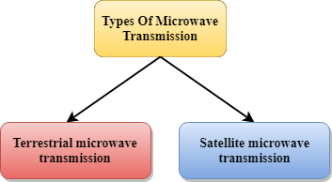
Microwave
Microwaves are of two types:
Use directional antennas - point to point line of sight communications.
Microwave communication.
Used for unicast communication such as cellular telephones, satellite networks.
Higher frequency ranges cannot efficiently penetrate walls.
Frequency Range: 1GHz – 300GHz.

Slide 42
Microwave - Characteristics
Frequency Range
The frequency range of terrestrial microwave is from 4-6 GHz to 21-23 GHz.
Bandwidth
It supports the bandwidth from 1 to 10 Mbps.
Short Distance
It is inexpensive for short distance.
Long Distance
It is expensive as it requires a higher tower for a longer distance.
Attenuation
Attenuation means loss of signal. It is affected by environmental conditions and antenna size.

Slide 43
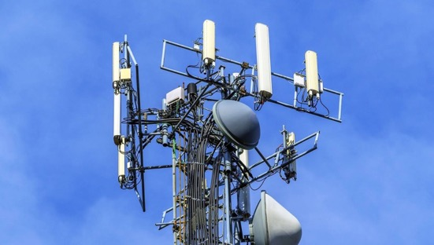
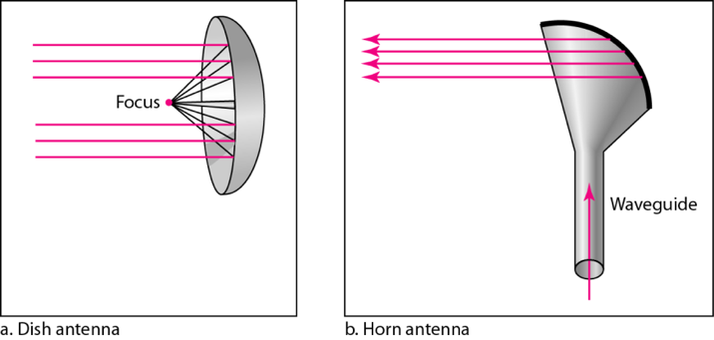
Terrestrial Microwave Transmission
It is a technology that transmits the focused beam of a radio signal from one ground-based microwave transmission antenna to another.
Microwaves are unidirectional as the sending and receiving antenna is to be aligned.
Antennas are mounted on the towers to send a beam to another antenna which is km away.
It works on the line of sight transmission.
The antennas mounted on the towers are the direct sight of each other.

Slide 44
Terrestrial Microwave Transmission – Cont.
Advantages Of Microwave transmission :
It is cheaper than using cables.
It is free from land acquisition as it does not require any land for the installation of cables.
It provides an easy communication in terrains as the installation of cable in terrain(area/field) is quite a difficult task.
Communication over oceans can be achieved by using microwave transmission.
Disadvantages of Microwave transmission :
Eavesdropping(intruder/spy): An eavesdropping creates insecure communication. Any malicious user can catch the signal in the air by using its own antenna.
Out of phase signal: Signals can arrive at the receiver slightly delayed and out of sync.
Susceptible to weather condition: A microwave transmission is susceptible to weather condition. This means that any environmental change such as rain, wind can distort the signal.
Bandwidth limited: Allocation of bandwidth is limited in the case of microwave transmission.

Slide 45
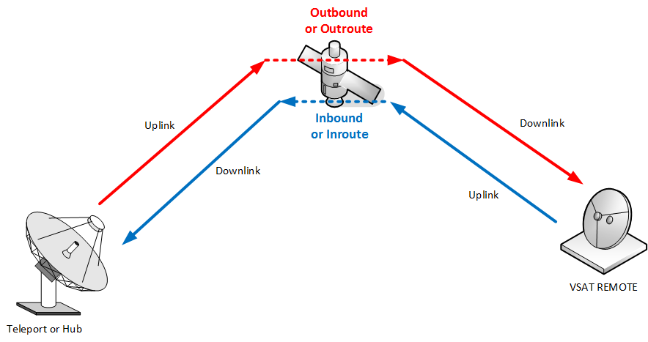
Satellite Microwave Communication
A satellite is a physical object that revolves around the earth at a known height.
Satellite communication is more reliable nowadays as it offers more flexibility than cable and fibre optic systems.
We can communicate with any point on the globe by using satellite communication.
How Does Satellite work?
The satellite accepts the signal that is transmitted from the earth station, and it amplifies the signal. The amplified signal is retransmitted to another earth station.

Slide 46
Satellite Microwave Communication – Cont.
Advantages Of Satellite Microwave Communication:
The coverage area of a satellite microwave is more than the terrestrial microwave.
The transmission cost of the satellite is independent of the distance from the centre of the coverage area.
It is used in mobile and wireless communication applications.
It is easy to install.
It is used in a wide variety of applications such as weather forecasting, radio/TV signal broadcasting, mobile communication, etc.
Disadvantages Of Satellite Microwave Communication:
Satellite designing and development requires more time and higher cost.
The Satellite needs to be monitored and controlled on regular periods so that it remains in orbit.
The life of the satellite is about 12-15 years. Due to this reason, another launch of the satellite has to be planned before it becomes non-functional.

Slide 47

Infrared wave
An infrared transmission is a wireless technology used for communication over short ranges.
The frequency of the infrared in the range from 300 GHz to 400 THz.
It is used for short-range communication.
For Example, the data transfer between two cell phones, TV remote operation, data transfer between a computer and cell phone resides in the same closed area.

Slide 48
Infrared Wave - Characteristics
Infrared waves cannot penetrate the walls.
Therefore, the infrared communication in one room cannot be interrupted by the nearby rooms.
An infrared communication provides better security with minimum interference.
Infrared communication is unreliable outside the building because the sun rays will interfere with the infrared waves.

Slide 49
Network Topologies

Slide 50
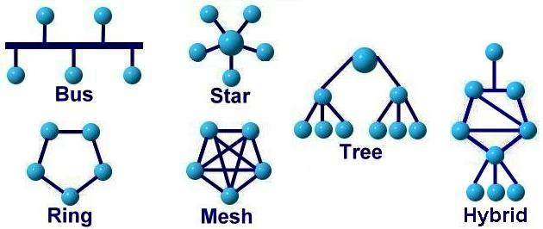
Network Topologies
Network topology is the arrangement of the various components (links, nodes, etc.) of a computer network.
Types of network topologies :
Bus
Ring
Star
Mesh
Tree
Hybrid

Slide 51
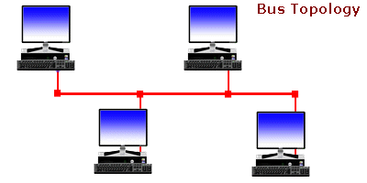
Bus Topology
Every computer and network device is connected to single cable.
It transmits data only in one direction.
When a node wants to send a message over the network, it puts a message over the network.
All the stations available in the network will receive the message whether it has been addressed or not.
Used in small networks.
Easy to expand joining two cables together.
It is used in early LAN connection.

Slide 52
Bus Topology – Advantages
Low-cost cable:
Nodes are directly connected to the cable without passing through a hub. Therefore, the initial cost of installation is low.
Moderate data speeds:
Coaxial or twisted pair cables are mainly used in bus-based networks that support upto 10 Mbps.
Familiar technology:
Bus topology is a familiar technology as the installation and troubleshooting techniques are well known, and hardware components are easily available.
Limited failure:
A failure in one node will not have any effect on other nodes.

Slide 53
Bus Topology – Disadvantages
Extensive cabling:
A bus topology is quite simpler, but still it requires a lot of cabling.
Difficult troubleshooting:
It requires specialized test equipment to determine the cable faults. If any fault occurs in the cable, then it would disrupt the communication for all the nodes.
Signal interference:
If two nodes send the messages simultaneously, then the signals of both the nodes collide with each other.
Reconfiguration difficult:
Adding new devices to the network would slow down the network.
Attenuation:
Attenuation is a loss of signal leads to communication issues. Repeaters are used to regenerate the signal.

Slide 54
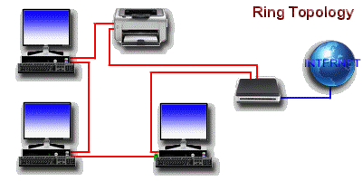
Ring Topology
It forms a ring as each computer is connected to another computer, with the last one connected to the first.
Transmission is unidirectional & sequential way that is bit by bit.
The data flows in a single loop continuously known as an endless loop.
The data in a ring topology flow in a clockwise direction.
Transmitting network is not affected by high traffic or by adding more nodes, as only the nodes having tokens can transmit data.
Cheap to install and expand.

Slide 55
Ring Topology – Advantages
Network Management:
Faulty devices can be removed from the network without bringing the network down.
Product availability:
Many hardware and software tools for network operation and monitoring are available.
Cost:
Twisted pair cabling is inexpensive and easily available. So, the installation cost is very low.
Reliable:
It is a more reliable network because the communication system is not dependent on the single host computer.

Slide 56
Ring Topology – Disadvantages
Difficult troubleshooting
It requires specialized test equipment to determine the cable faults. If any fault occurs in the cable, then it would disrupt the communication for all the nodes.
Failure
The breakdown in one station leads to the failure of the overall network.
Reconfiguration difficult
Adding new devices to the network would slow down the network.
Delay
Communication delay is directly proportional to the number of nodes. Adding new devices increases the communication delay.

Slide 57
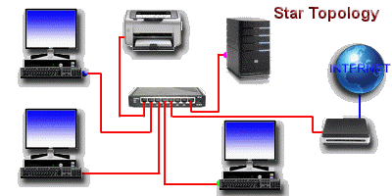
Star Topology
Computers are connected to a single central hub through a cable.
Fast performance with few nodes and low network traffic.
Easy to troubleshoot & Easy to setup and modify.
Only that node is affected which has failed rest of the nodes can work smoothly.
Hub can be upgraded easily.

Slide 58
Star Topology - Advantages
Efficient troubleshooting
All the stations are connected to the centralized network. So, the network administrator has to go to the single station to troubleshoot the problem.
Centralized Network control
The hub acts as a central point for network management and control.
Limited failure
As each station is connected to the central hub with its own cable, therefore failure in one cable will not affect the entire network.
Easily expandable
It is easily expandable as new stations can be added to the open ports on the hub.
High data speeds
It supports a bandwidth of approx. 100Mbps.

Slide 59
Star Topology - Disadvantages
A Central point of failure
If the central hub or switch goes down, then all the connected nodes will not be able to communicate with each other.
Cabling Costs and Complexity
Each device in a star topology requires a dedicated cable to connect to the central hub. This can lead to significant cabling costs, especially in larger networks with many devices.

Slide 60
Mesh Topology
Point-to-point connection to other devices or fully connected.
Traffic is carried only between two connected devices.
Robust, costly but not flexible.
Fault is diagnosed easily.
More cable resource used in setup.

Slide 61
Mesh Topology - Advantages
Reliable
The mesh topology networks are very reliable as if any link breakdown, it will not affect the communication between connected computers.
Fast Communication
Communication is very fast between the nodes.
Easier Reconfiguration
Adding new devices would not disrupt the communication between other devices.

Slide 62
Mesh Topology - Disadvantages
Cost
A mesh topology contains a large number of connected devices such as a router and more transmission media than other topologies.
Management
Mesh topology networks are very large and very difficult to maintain and manage. If the network is not monitored carefully, then the communication link failure goes undetected.
Efficiency
In this, redundant connections are high that reduces the efficiency of the network.

Slide 63
Tree Topology
It has a root node and all other nodes are connected to it forming a hierarchy.
Also called hierarchical topology.
Mostly used in Wide Area Network – WAN.
Expansion of nodes is possible and easy.
Easily managed and maintained.

Slide 64
Tree Topology - Advantages
Support for broadband transmission
Tree topology is mainly used to provide broadband transmission, i.e., signals are sent over long distances without being attenuated.
Easily expandable
We can add the new device to the existing network. Therefore, we can say that tree topology is easily expandable.
Easily manageable
In tree topology, the whole network is divided into segments known as star networks which can be easily managed and maintained.
Error detection
Error detection and error correction are very easy in segments in a tree topology.
Point-to-point wiring
It has point-to-point wiring for individual segments.

Slide 65
Tree Topology - Disadvantages
Difficult troubleshooting
If any fault occurs in the node, then it becomes difficult to troubleshoot the problem if tree structure is very deep.
High cost
Devices required for broadband transmission are very costly.
Failure
A tree topology mainly relies on main bus cable and failure in main bus cable will damage the overall network.
Reconfiguration difficult
If new devices are added, then it becomes difficult to reconfigure.

Slide 66
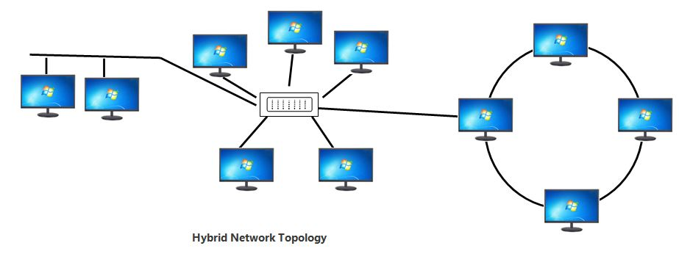
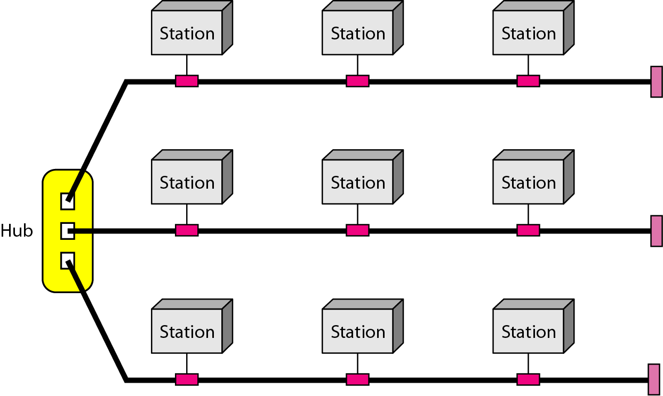
Hybrid Topology
A network structure whose design contains more than one topology is said to be hybrid topology.
It is a combination of two or more topologies.
Flexible & reliable as error detection and easy to troubleshoot.
Scalable as size can be increased easily.

Slide 67
Comparison of Topologies
 | Bus | Ring | Star | Mesh | Tree
Means | every computer and network device is connected to single cable. | Each computer is connected to another, with the last one connected to the first. | All the computers are connected to a single hub through a cable. | All the network nodes are connected to each other. | It has a root node and all other nodes are connected to it forming a hierarchy.
Cost | Average | Cheap | High | High | High
Used in | Small Network | Expand Network | Small Network | Expand Network | Expand Network
Troubleshoot | Easy, But Cables fail then whole network fails. | Difficult; Failure of one computer disturbs the whole network. | Easy; If the hub fails then the whole network is down. | Difficult; Installation and configuration is difficult. | Easy; Central root hub fails, network fails.

Slide 68
Protocol Layers

Slide 69
Protocols Layers
To deals with connecting systems that are open for communication with other systems.
OSI Layer Model (Open Systems Interconnection)
Developed by the International Standards Organization (ISO) with seven different layers.
Physical Layer
Data Link Layer
Network Layer
Transport Layer
Session Layer
Presentation Layer
Application Layer

Slide 70
Example – Air Plane Travel
Departure
Arrival
ticket (purchase)
baggage (check)
gates (load)
runway takeoff
airplane routing
ticket (complain)
baggage (claim)
gates (unload)
runway landing
airplane routing
airplane routing

Slide 71
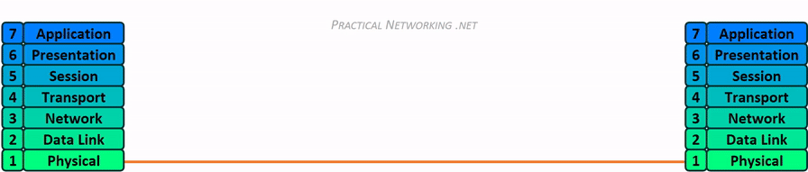

How OSI Layer Works?

Slide 72
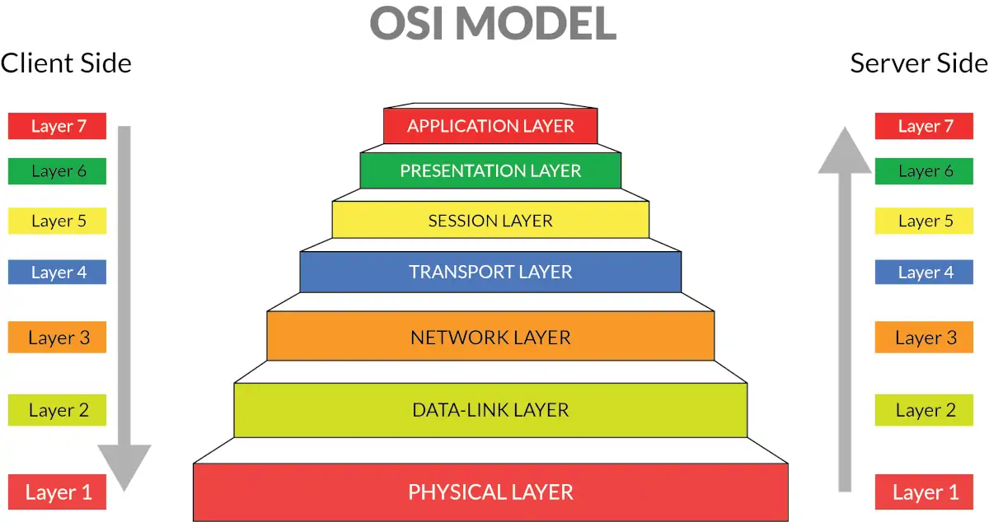
Open Systems Interconnect (OSI) OSI Reference Model

Slide 73
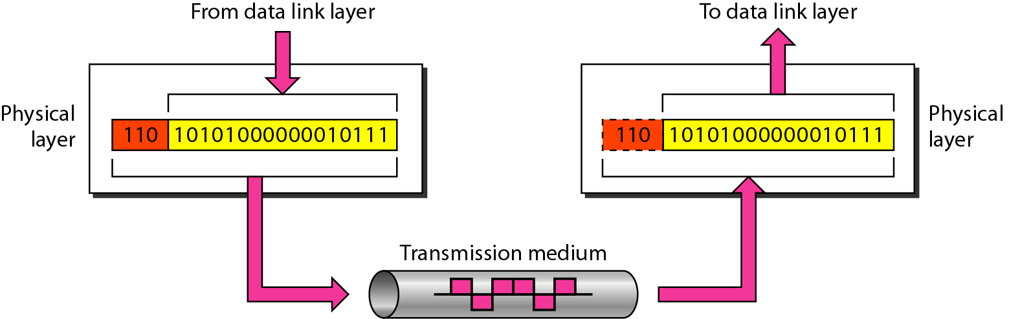
Physical Layer
The physical layer is responsible for movements of individual bits from one hop (node) to the next.

Slide 74
Physical Layer
It is the lowest layer of the OSI model.
It is responsible for the actual physical connection between the devices.
It establishes, maintains and deactivates the physical connection.
The physical layer contains information in the form of bits.
The main functionality of the physical layer is to transmit the individual bits from one node to another node.
This layer will get the signal and send it to the Data Link layer.
Hub, Repeater, Modem, Cables are Physical Layer devices

Slide 75
Functions of a Physical layer
Line Configuration
It defines the way how two or more devices can be connected physically.
Signals
It determines the type of the signal used for transmitting the information.
Bit synchronization
It provides the synchronization of the bits by providing a clock. This clock controls both sender and receiver thus providing synchronization at bit level.
Bit rate control
It also defines the transmission rate i.e. the number of bits sent per second.
Physical topologies
It specifies the way in which the different, devices/nodes are arranged in a network i.e. bus, star, or mesh topology.
Transmission mode
It also defines the way in which the data flows between the two connected devices.
The various transmission modes possible are Simplex, half-duplex and full-duplex.

Slide 76
Physical Layer – Cont.
Carries the bit stream over a physical media.
Physical Layer is concerned with:
Interface and Medium like guided cables
Representation of bits
Data rate
Synchronization of bits
Line configuration
Physical topology
Transmission mode

Slide 77
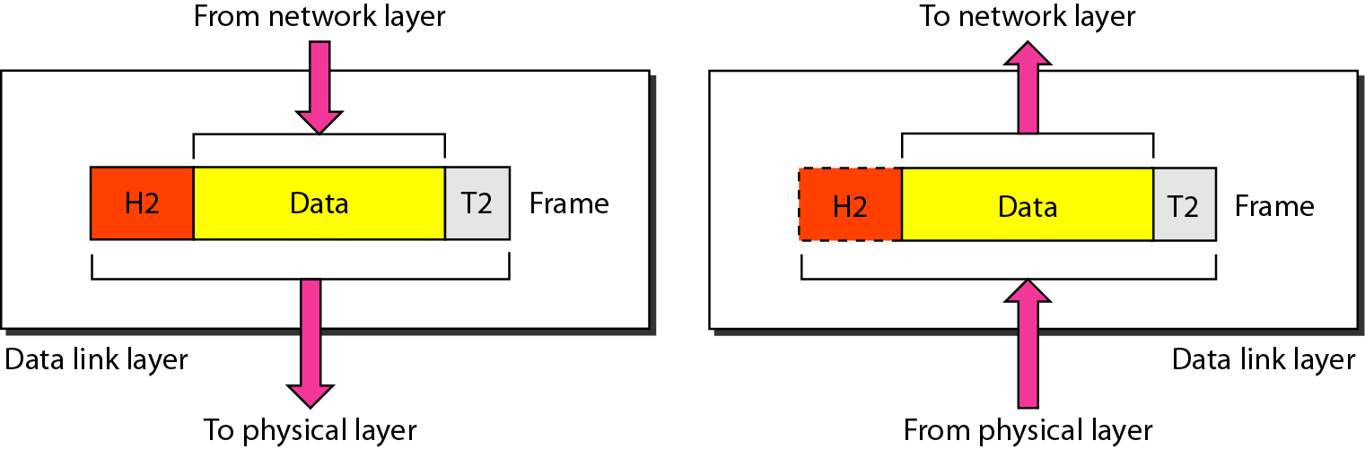
Data Link Layer
The data link layer is responsible for moving frames from one hop (node) to the next.

Slide 78
Data-Link Layer – Cont.
This layer is responsible for the error-free transfer of data frames.
It provides hop-to-hop delivery.
It defines the format of the data on the network.
It provides a reliable and efficient communication.
It is mainly responsible for the unique identification of each device that resides on a local network.
When a packet arrives in a network, it is the responsibility of DLL to transmit it to the Host using its MAC address
Packet in Data Link layer is referred to as Frame
Data Link layer is handled by the NIC (Network Interface Card) and device drivers of host machines
Switch & Bridge are Data Link Layer devices.

Slide 79
Data-Link Layer – Cont.
Data Link Layer is divided into two sublayers:
Logical Link Control Layer
It is responsible for transferring the packets to the Network layer.
It identifies the address of the network layer protocol from the header.
It also provides flow control.
Error detection, using Ethernet trailer field frame check sequence (FCS).
Media Access Control Layer
Provides physical addressing
A Media access control layer is a link between the Logical Link Control layer and the network's physical layer.
It is used for transferring the packets over the network.
The packet received from the Network layer is further divided into frames depending on the frame size of NIC (Network Interface Card).
DLL also encapsulates Sender and Receiver’s MAC address in the header.

Slide 80
Functions of the Data-link layer
Framing
Framing is a function of the data link layer.
The data link layer translates the physical's raw bit stream into packets known as Frames.
Breaks messages into frames and reassembles frames into messages
Attaching special bit patterns to the beginning and end of the frame.
The Data link layer adds the header and trailer to the frame.
Physical Addressing
The Data link layer adds a header to the frame that contains destination and source addresses.
The frame is transmitted to the destination address mentioned in the header.
Header | Packet | Trailer

Slide 81
Functions of the Data-link layer
Flow Control:
It is the main functionality of the Data-link layer.
It is the technique through which the constant data rate is maintained on both the sides so that no data get corrupted.
It keeps a fast transmitter from flooding a slow receiver.
Error Control:
Adding a calculated value CRC (Cyclic Redundancy Check) that is placed to the DLL’s trailer.
The CRC is added to the message frame before it is sent to the physical layer.
If any error seems to occur, then the receiver sends the acknowledgment for the retransmission of the corrupted frames.
DLL provides the mechanism of error control in which it detects and retransmits damaged or lost frames.
Access Control:
When two or more devices are connected to the same communication channel, then
DLL protocol are used to define which device has control over the communication link at a given time.

Slide 82
Data Link Layer – Cont.
Data link layer is concerned with:
Framing – divide bits stream into data unit (frame)
Physical addressing
Flow control – avoid over overwhelming
Error control – bit loses, retransmission
Access control

Slide 83
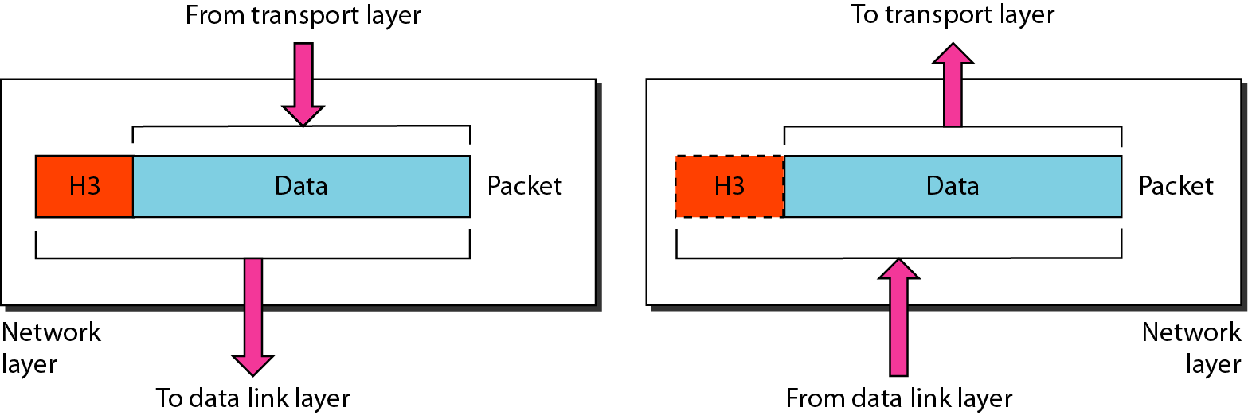
Network Layer
The network layer is responsible for the delivery of individual packets from the source host to the destination host.

Slide 84
Functions of Network Layer
Internetworking
An internetworking is the main responsibility of the network layer.
It provides a logical connection between different devices.
Addressing
In order to identify each device on internetwork uniquely, the network layer defines an addressing scheme.
A Network layer adds the source and destination IP addresses to the header of the frame.
Addressing is used to identify the device uniquely and universally on the internet.
Routing
Routing is the major component of the network layer, and it determines the best optimal path out of the multiple paths from source to the destination.
Packetizing
A Network Layer receives the packets from the upper layer and converts them into packets.
This process is known as Packetizing.
It is achieved by internet protocol (IP).

Slide 85
Network Layer – Cont…
In this layer, packet is combined with header and data.
In case of data link layer, packet delivers on the same network.
If two different networks are connected then packet is concern with network layer.
Network layer is concerned with:
Logical addressing e.g. 192.168.1.1 (IP Address)
Routing

Slide 86
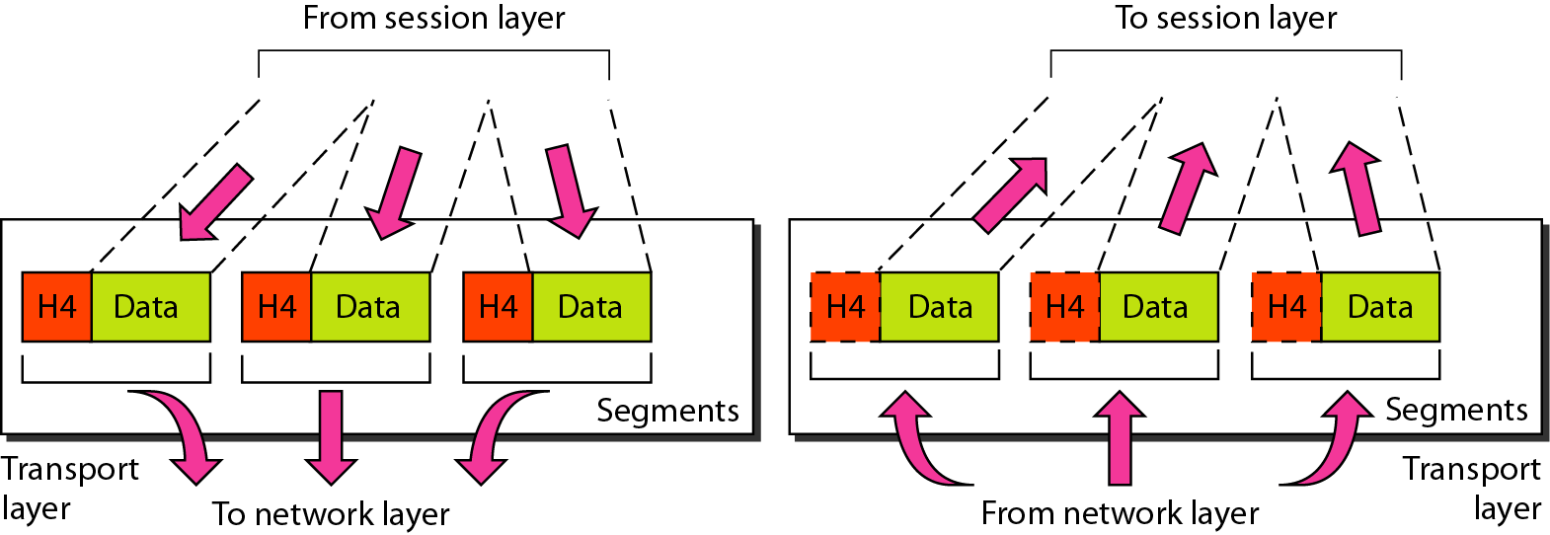
Transport Layer
The transport layer is responsible for the delivery of a message from one process to another.

Slide 87
Functions of Transport Layer
At sender’s side:
Transport layer receives the formatted data from the upper layers, performs Segmentation,
Implements Flow & Error control to ensure proper data transmission.
It also adds Source and Destination port numbers (which is associated with the receiver’s application) in its header and forwards the segmented data to the Network Layer.
Generally, this destination port number is configured, either by default or manually.
For example, a web server typically uses port number 80 by default.
At receiver’s side:
Transport Layer reads the port number from its header and forwards the Data that it has received to the respective application.
It also performs sequencing and reassembling of the segmented data.

Slide 88
Transport Layer – Cont.
This layer ensures that the whole message arrives intact and in order.
Transport layer is concerned with:
Service-point addressing (port address)
Segmentation and Reassembly
Connection Control
Flow and Error Control

Slide 89
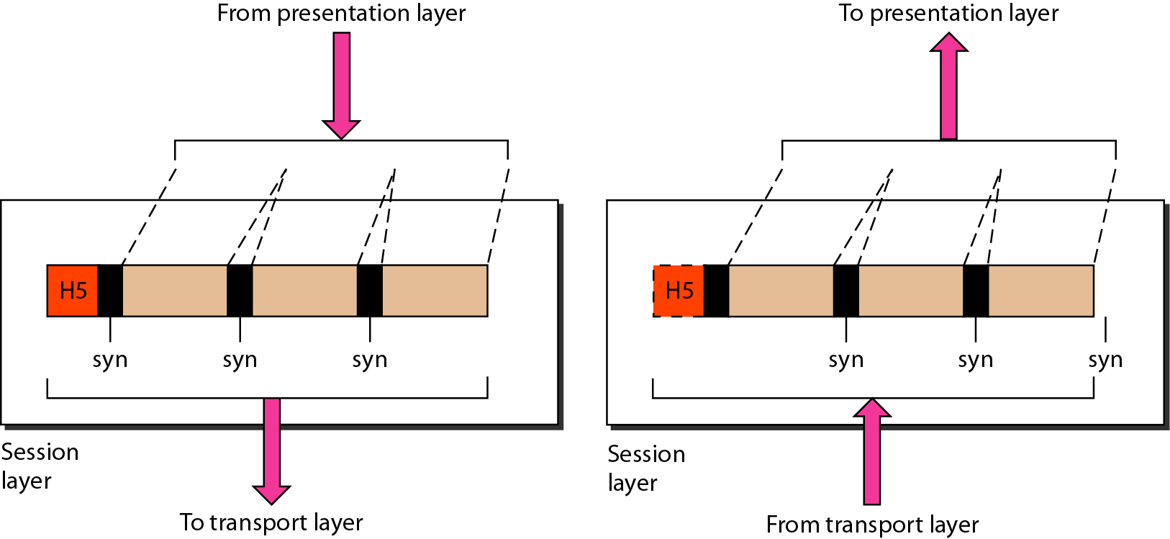
Session Layer
The session layer is responsible for dialog control and synchronization.

Slide 90
Functions of Session layer
Session establishment, maintenance, and termination:
The layer allows the processes to establish, use and terminate a connection.
Dialog control:
Session layer acts as a dialog controller that creates a dialog between two processes.
In simple words, it allows the communication between two processes which can be either half-duplex or full-duplex.
Synchronization:
Session layer adds some checkpoints when transmitting the data in a sequence.
If some error occurs in the middle of the transmission of data, then the transmission will take place again from the checkpoint.
This process is known as synchronization and recovery.
Data loss is avoided by it.

Slide 91
Session Layer – Cont…
This layer is network dialog controller – establishes, maintains, synchronizes the interaction among computers.
Session layer is concerned with:
Dialog control
Synchronization

Slide 92
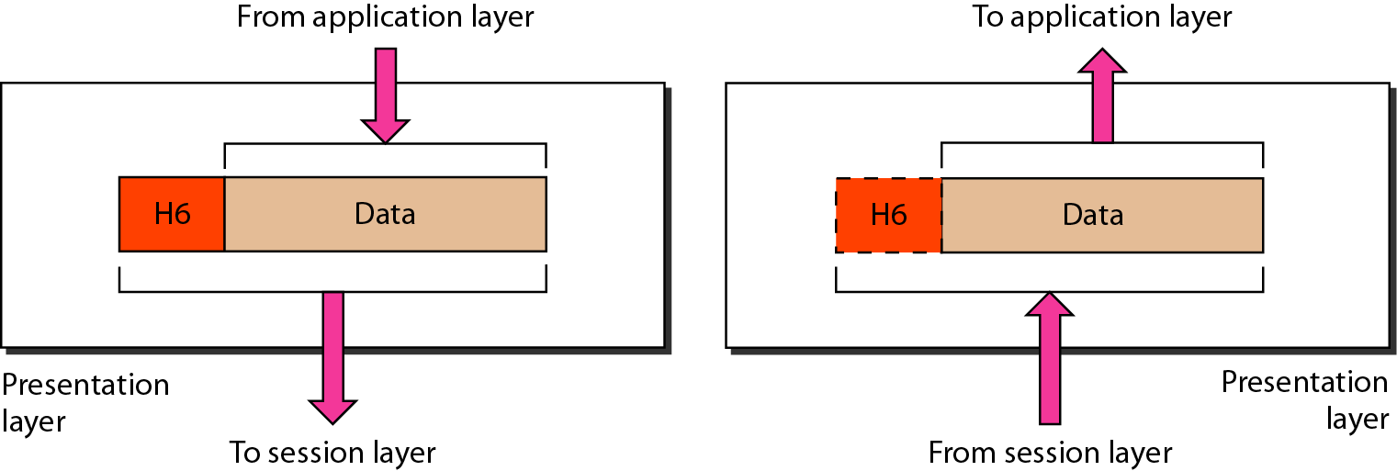
Presentation Layer
The presentation layer is responsible for translation, compression, and encryption.

Slide 93
Presentation Layer
The presentation layer is also called the Translation layer.
The data from the application layer is extracted here and manipulated as per the required format to transmit over the network.
This layer is a part of the operating system that converts the data from one presentation format to another format.
The Presentation layer is also known as the syntax layer.

Slide 94
Functions of Presentation layer
Translation
It acts as a data translator for a network, for example, ASCII to EBCDIC
The processes in two systems exchange the information in the form of character strings, numbers and so on.
Different computers use different encoding methods, the presentation layer handles the interoperability between the different encoding methods.
It converts the data from sender-dependent format into a common format and changes the common format into receiver-dependent format at the receiving end.
Encryption
Encryption is needed to maintain privacy.
Data encryption translates the data into another form or code.
The encrypted data is known as the ciphertext and the decrypted data is known as plain text.
A key value is used for encrypting as well as decrypting data
Compression
Data compression reduces the number of bits that need to be transmitted on the network
Data compression is very important in multimedia such as text, audio, video.

Slide 95
Presentation Layer – Cont.
This layer is concerned with the syntax which refers to order in which data is presented and semantics helps in interpreting a particular pattern.
Presentation layer is responsible for:
Translation
Encryption
Compression

Slide 96
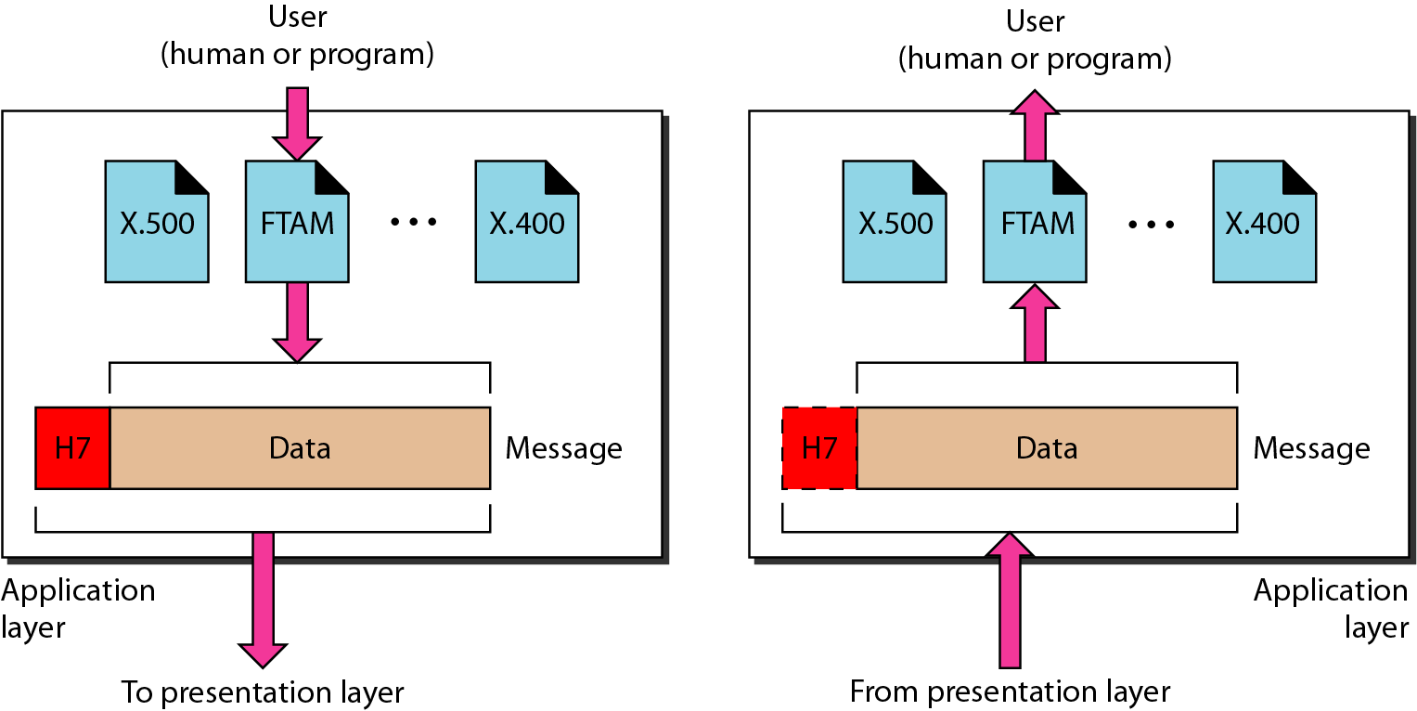
Application Layer
The application layer is responsible for providing services to the user.

Slide 97
Application Layer
Application layer, which is implemented by the network applications is the top most layer of the OSI OSI Reference Model.
These applications produce the data, which has to be transferred over the network.
This layer also serves as a window for users and the application services to access the network and for displaying the received information to the user.
It handles issues such as network transparency, resource allocation, etc.
This layer provides the network services to the end-users.
Example: Application – Browsers, Skype Messenger, etc.
Application Layer is also called Desktop Layer.

Slide 98
Functions of Application layer
File transfer, access, and management (FTAM)
An application layer allows a user to access the files in a remote computer, to retrieve the files from a computer and to manage the files in a remote computer.
Mail services
An application layer provides the facility for email forwarding and storage.
Directory services
An application provides the distributed database sources and is used to provide that global information about various objects.

Slide 99
Application Layer – Cont.
This layer provides various services like:
Network virtual terminal
File transfer, access and management
Mail services
Directory services

Slide 100
Summary – OSI Layer
To allow access to network resource
Application
To translate, encrypt and compress data
Presentation
To establish, manage and terminate sessions
To provide reliable process-to-process message delivery and error recovery
Session
Transport
To move packets from source to destination; To provide internetworking
Network
To organize bits into frames; To provide hop-to-hop delivery
Data link
To transmit bits over a medium; To provide mechanical & electrical specification
Physical

Slide 101
TCP/IP Reference Model (Transmission Control Protocol/Internet Protocol)
It was originally defined as having five layers:
TCP/IP is a set of protocols developed to allow cooperating computers to share resources across the network.
Application Layer
Transport Layer
Network Layer
Data Link Layer
Physical Network

Slide 102
TCP/IP Model Architecture

Slide 103
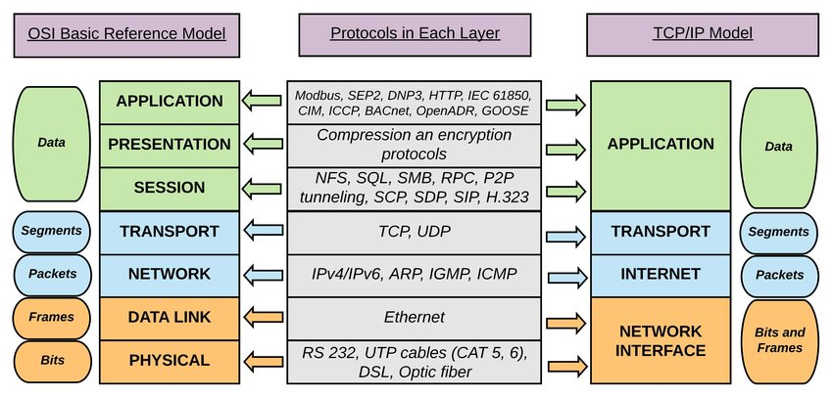
Comparison

Slide 104


Difference - OSI Model and TCP/IP Protocol Layers
OSI Model
&
TCP/IP Protocol Layer
OSI (Open System Interconnection) | TCP/IP (Transmission Control Protocol/ Internet Protocol)
It has 7 layers | It has 5 layers
OSI provides layer functioning and also defines functions of all the layers | TCP/IP model is more based on protocols and protocols are not flexible with other layers
OSI model has a separate presentation layer | TCP/IP doesn’t have a separate presentation layer
Network layer of OSI model provide both connection oriented and connectionless service | The Network layer in TCP/IP model provides connectionless service
In OSI model the transport layer guarantees the delivery of packets | In TCP/IP model the transport layer does not guarantees delivery of packets

Slide 105
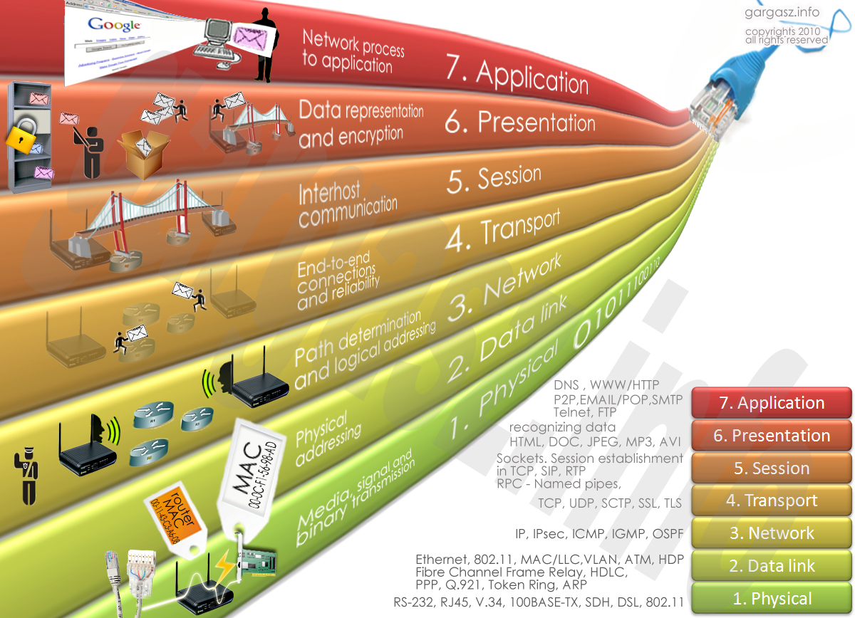
Protocol Layers: Summary

Slide 106
Delay, Loss & Throughput
Delay
As a packet travels from one node (host or router) to the subsequent node (host or router) along this path, the packet suffers from several types of delays at each node along the path.
Where
d_{nodal} = d_{proc} + d_{queue} + d_{tran} + d_{prop}
d_{nodal} | = | Total Delay
d_{proc} | = | Processing Delay
d_{que} | = | Queuing Delay
d_{tran} | = | Transmission Delay
d_{prop} | = | Propagation Delay

Slide 107
Delay – Cont…
Processing Delay (d_{proc})
The time required to examine the packets header and determine where to direct the packet.
To check bit level error
Determine output link
Delay in terms of microseconds

Slide 108
Delay – Cont…
Queuing Delay (d_{queue})
A time to wait at output link for transmission.
Depends on congestion level of router.
If queue is empty, then delay will be zero.
If queue is full (heavy traffic) then delay will be long.
Delay in terms of microsecond to millisecond.

Slide 109
Delay – Cont…
Transmission Delay (d_{tran} = L/R)
An amount of time required for the router to transmit the packet.
It is depending on packet length(L) and transmission rate(R) of link.

Slide 110
Delay – Cont…
Propagation Delay (d_{prop}= d/s)
A time required to propagate from the beginning of the link to router B.
Depends on the length of physical medium(d) link and propagation speed(s) of link
Delay in terms of millisecond.

Slide 111
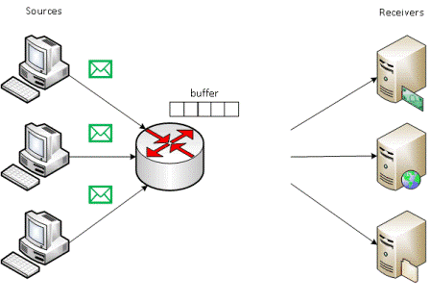
Packet Loss
Packet loss is the failure of one or more transmitted packets to arrive at their destination.
The loss of data packets depends on the switch queue/buffer. The loss of data packets increases with the increases in the traffic intensity.
It affects the performance
of the network.

Slide 112

Throughput
Throughput or Network Throughput is the rate of successful message delivery over a communication channel.
Throughput is measured in bits(data) per second (bit/s or bps)
If R_{s} < R_{c} then average end-to-end throughput will be R_{s}
If R_{c} < R_{s} then average end-to-end throughput will be R_{c}
In general, min(R_{c,} R_{s).}
server, with
file of F bits
send to client
link capacity
R_{s} bits/sec
link capacity
R_{c} bits/sec
Client

Slide 113

Throughput conti..
When there is 10 connections
Per-connection throughput =
min(Rc​,Rs​,R/10​)
Rc​: The capacity of the client's access link
Rs​: The capacity of the server's access link
R/10​: The fair share of the bottleneck link
when 10 connections are sharing it.
R is the total capacity of the bottleneck link
Since 10 connections are sharing

Slide 114
History of Computer Networks
1961-1972 : The development of Packet Switching
1972-1980 : Proprietary Network and Internetworking
1980-1990 : A Proliferation of Networks
1990s : The Internet Explosion
Recent Developments…

Slide 115
Outline - Revised
What is Computer Network? Connected each other
Advantages of Computer Network
Applications of Computer Network
Type of Computer Network LAN, MAN, WAN
What is Internet? Infinite nos. of connected computers across the world
What is Protocol? Set of Rules
The Network Edge Host-end system & edge router
The Network Core Circuit Switched & Packet Switched
Transmission Media Guided- Wired & Unguided-Wireless
Network Topologies Bus, Ring, Star, Mesh, Tree, & Hybrid
Protocol Layers OSI Layer & TCP/IP Layer
Delay, Loss & Throughput

Slide 116
Computer Networks (CN)
DU #2305CS332
Prof. Devangi L. Kotak
Department of Computer Application
Devangi.kotak@darshan.ac.in

